Slide 1
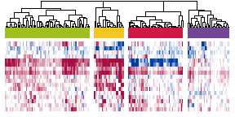
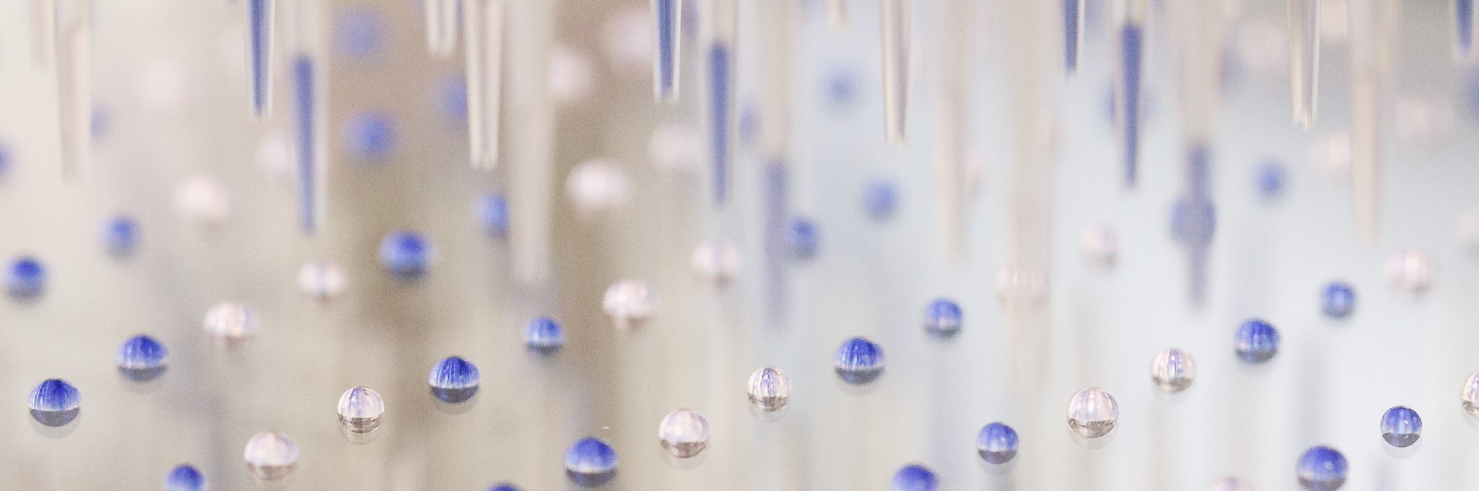
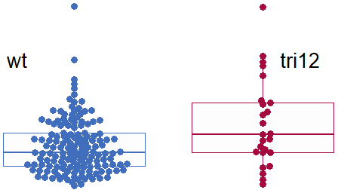
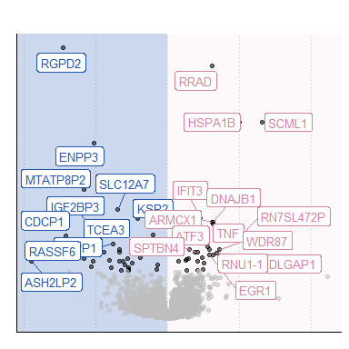

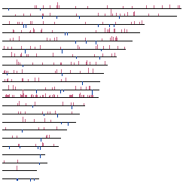
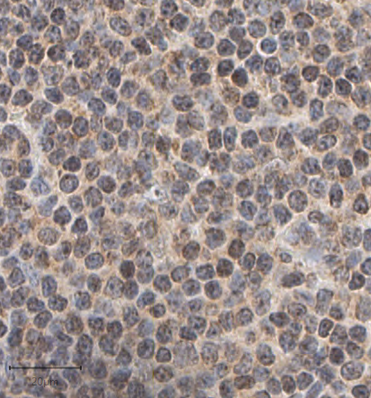
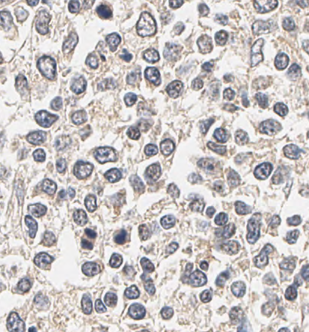
4 Microenvironmental response subgroups
192 CLL samples
High throughput ex vivo combination assay
Trisomy 12 enhances stimuli response
17 Stimuli
12 Drugs
Microenvironmental signaling is increased in CLL lymph nodes
Genome
Transcriptome
TF activity
CLL
Healthy

Slide 2
Combinatorial screening
Drugs
Stimuli
CLL cells
ex-vivo culture

